Slide 1

Year 9 Electricity
Introduction to Circuits

Slide 2
Learning Objective
To understand why some circuits fail to work.
Success Criteria
To identify the symbols used to represent components in a circuit.
To describe why some circuits do not work.
To apply our knowledge of circuits to an exam question.

Slide 3







Starter: Symbols
Everyday we see lots of different symbols. What are these symbols and what do they represent?

Slide 4
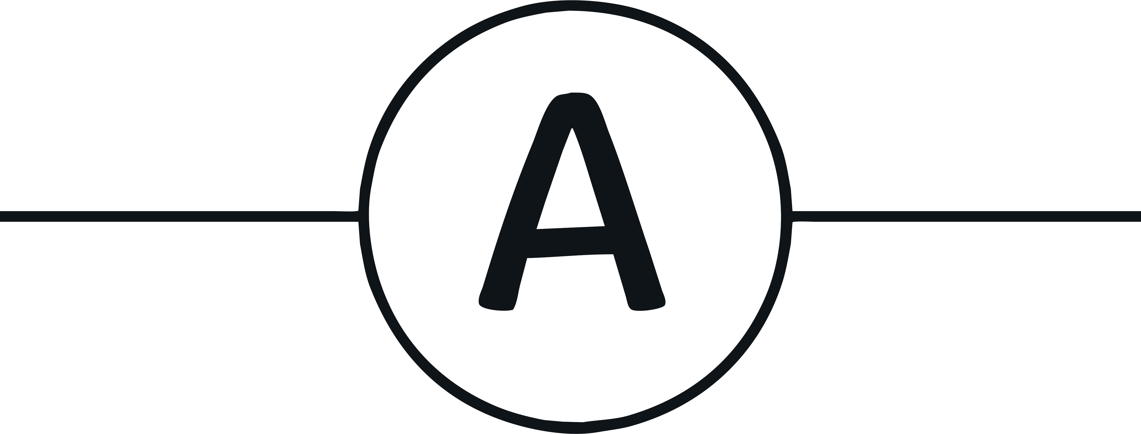

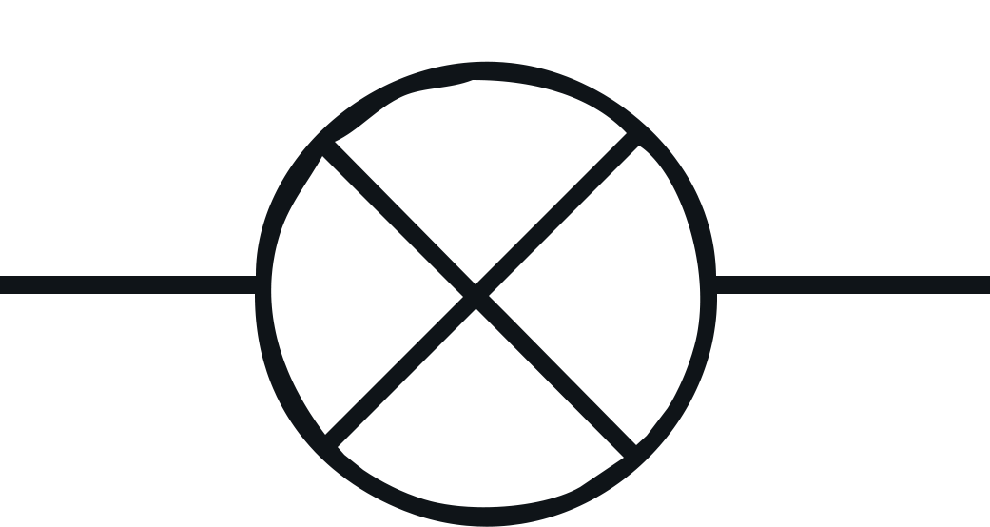
What are Circuit Symbols?
Electrical circuits are often represented by circuit diagrams. Rather than spending lots of time creating very artistic drawings of circuits, we use standard symbols that are much simpler, easier to draw and easier to interpret.
The symbols represent components such as a bulb, ammeter and voltmeter that can be used in a circuit diagram.
Circuits can be drawn in series where one component comes after the other or in parallel.
Notes:
Why do we use symbols?

Slide 5


Find a Friend
You may have some knowledge from primary school or Year 7/8 about electrical circuit symbols.
Let’s see what you know.
Give each student in the class one of the cards. Students should then move around the room and find their two ‘friends’ with the matching name, symbol and description.

Slide 6

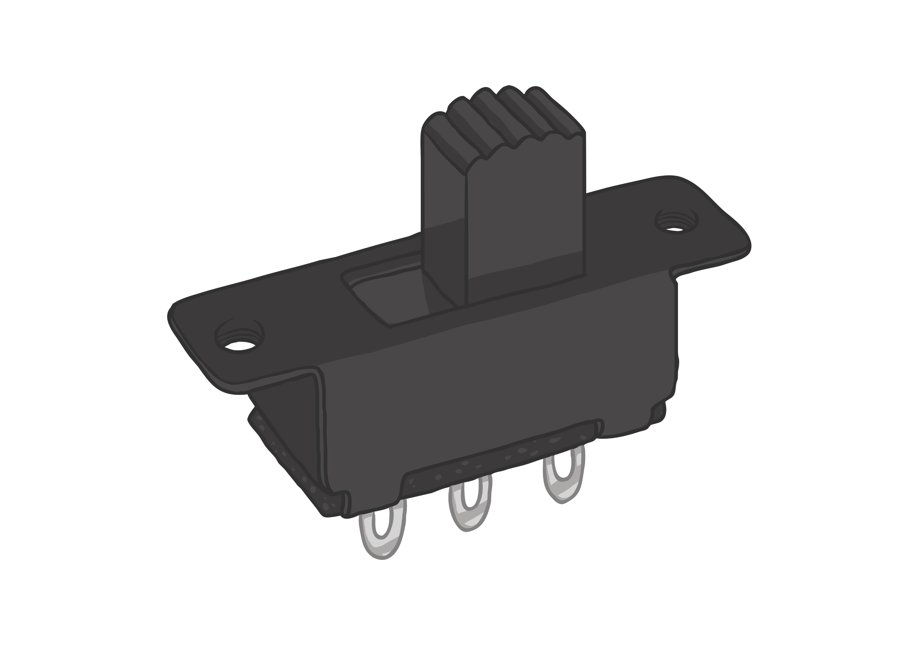

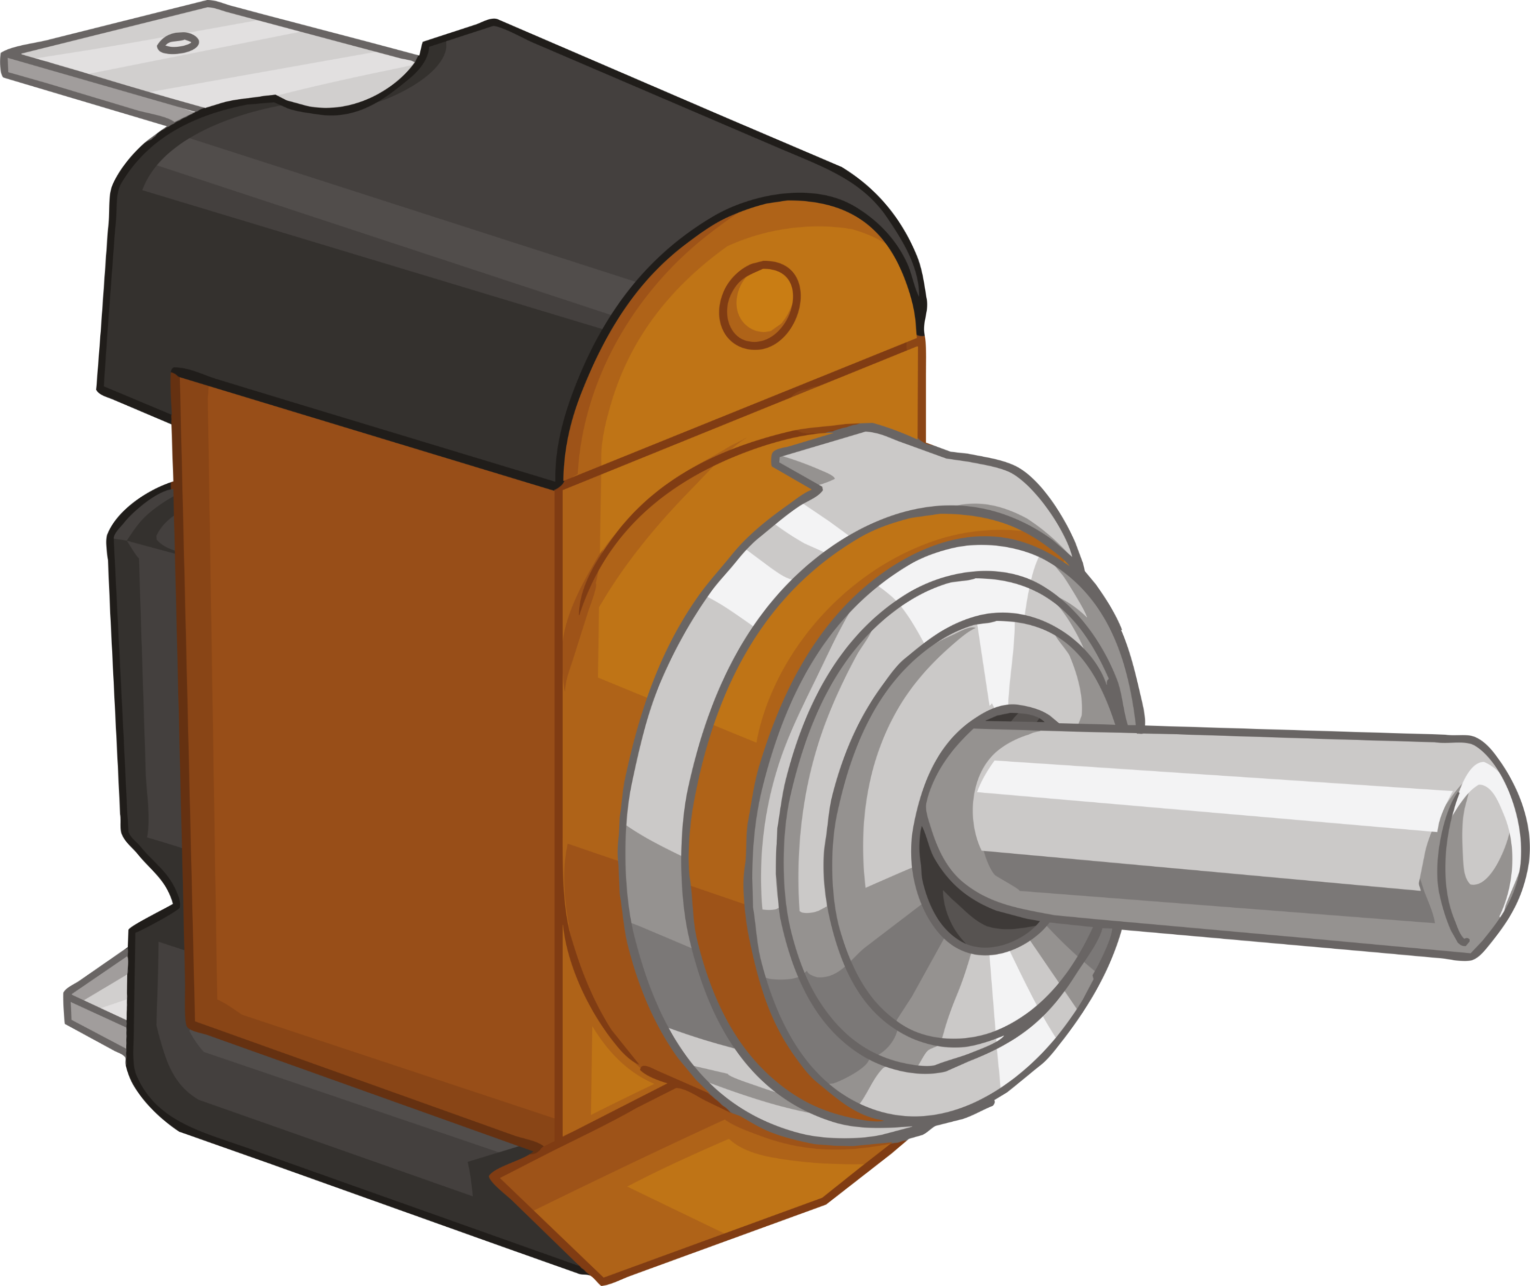
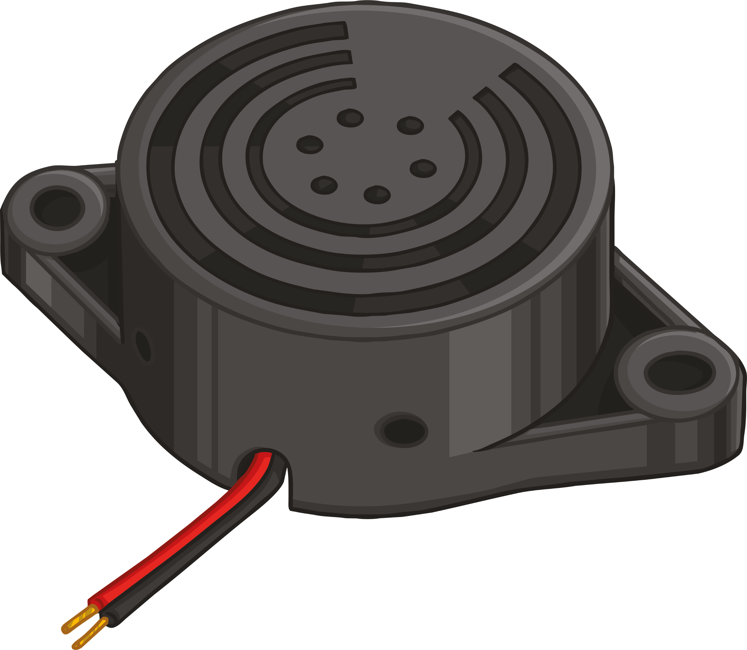


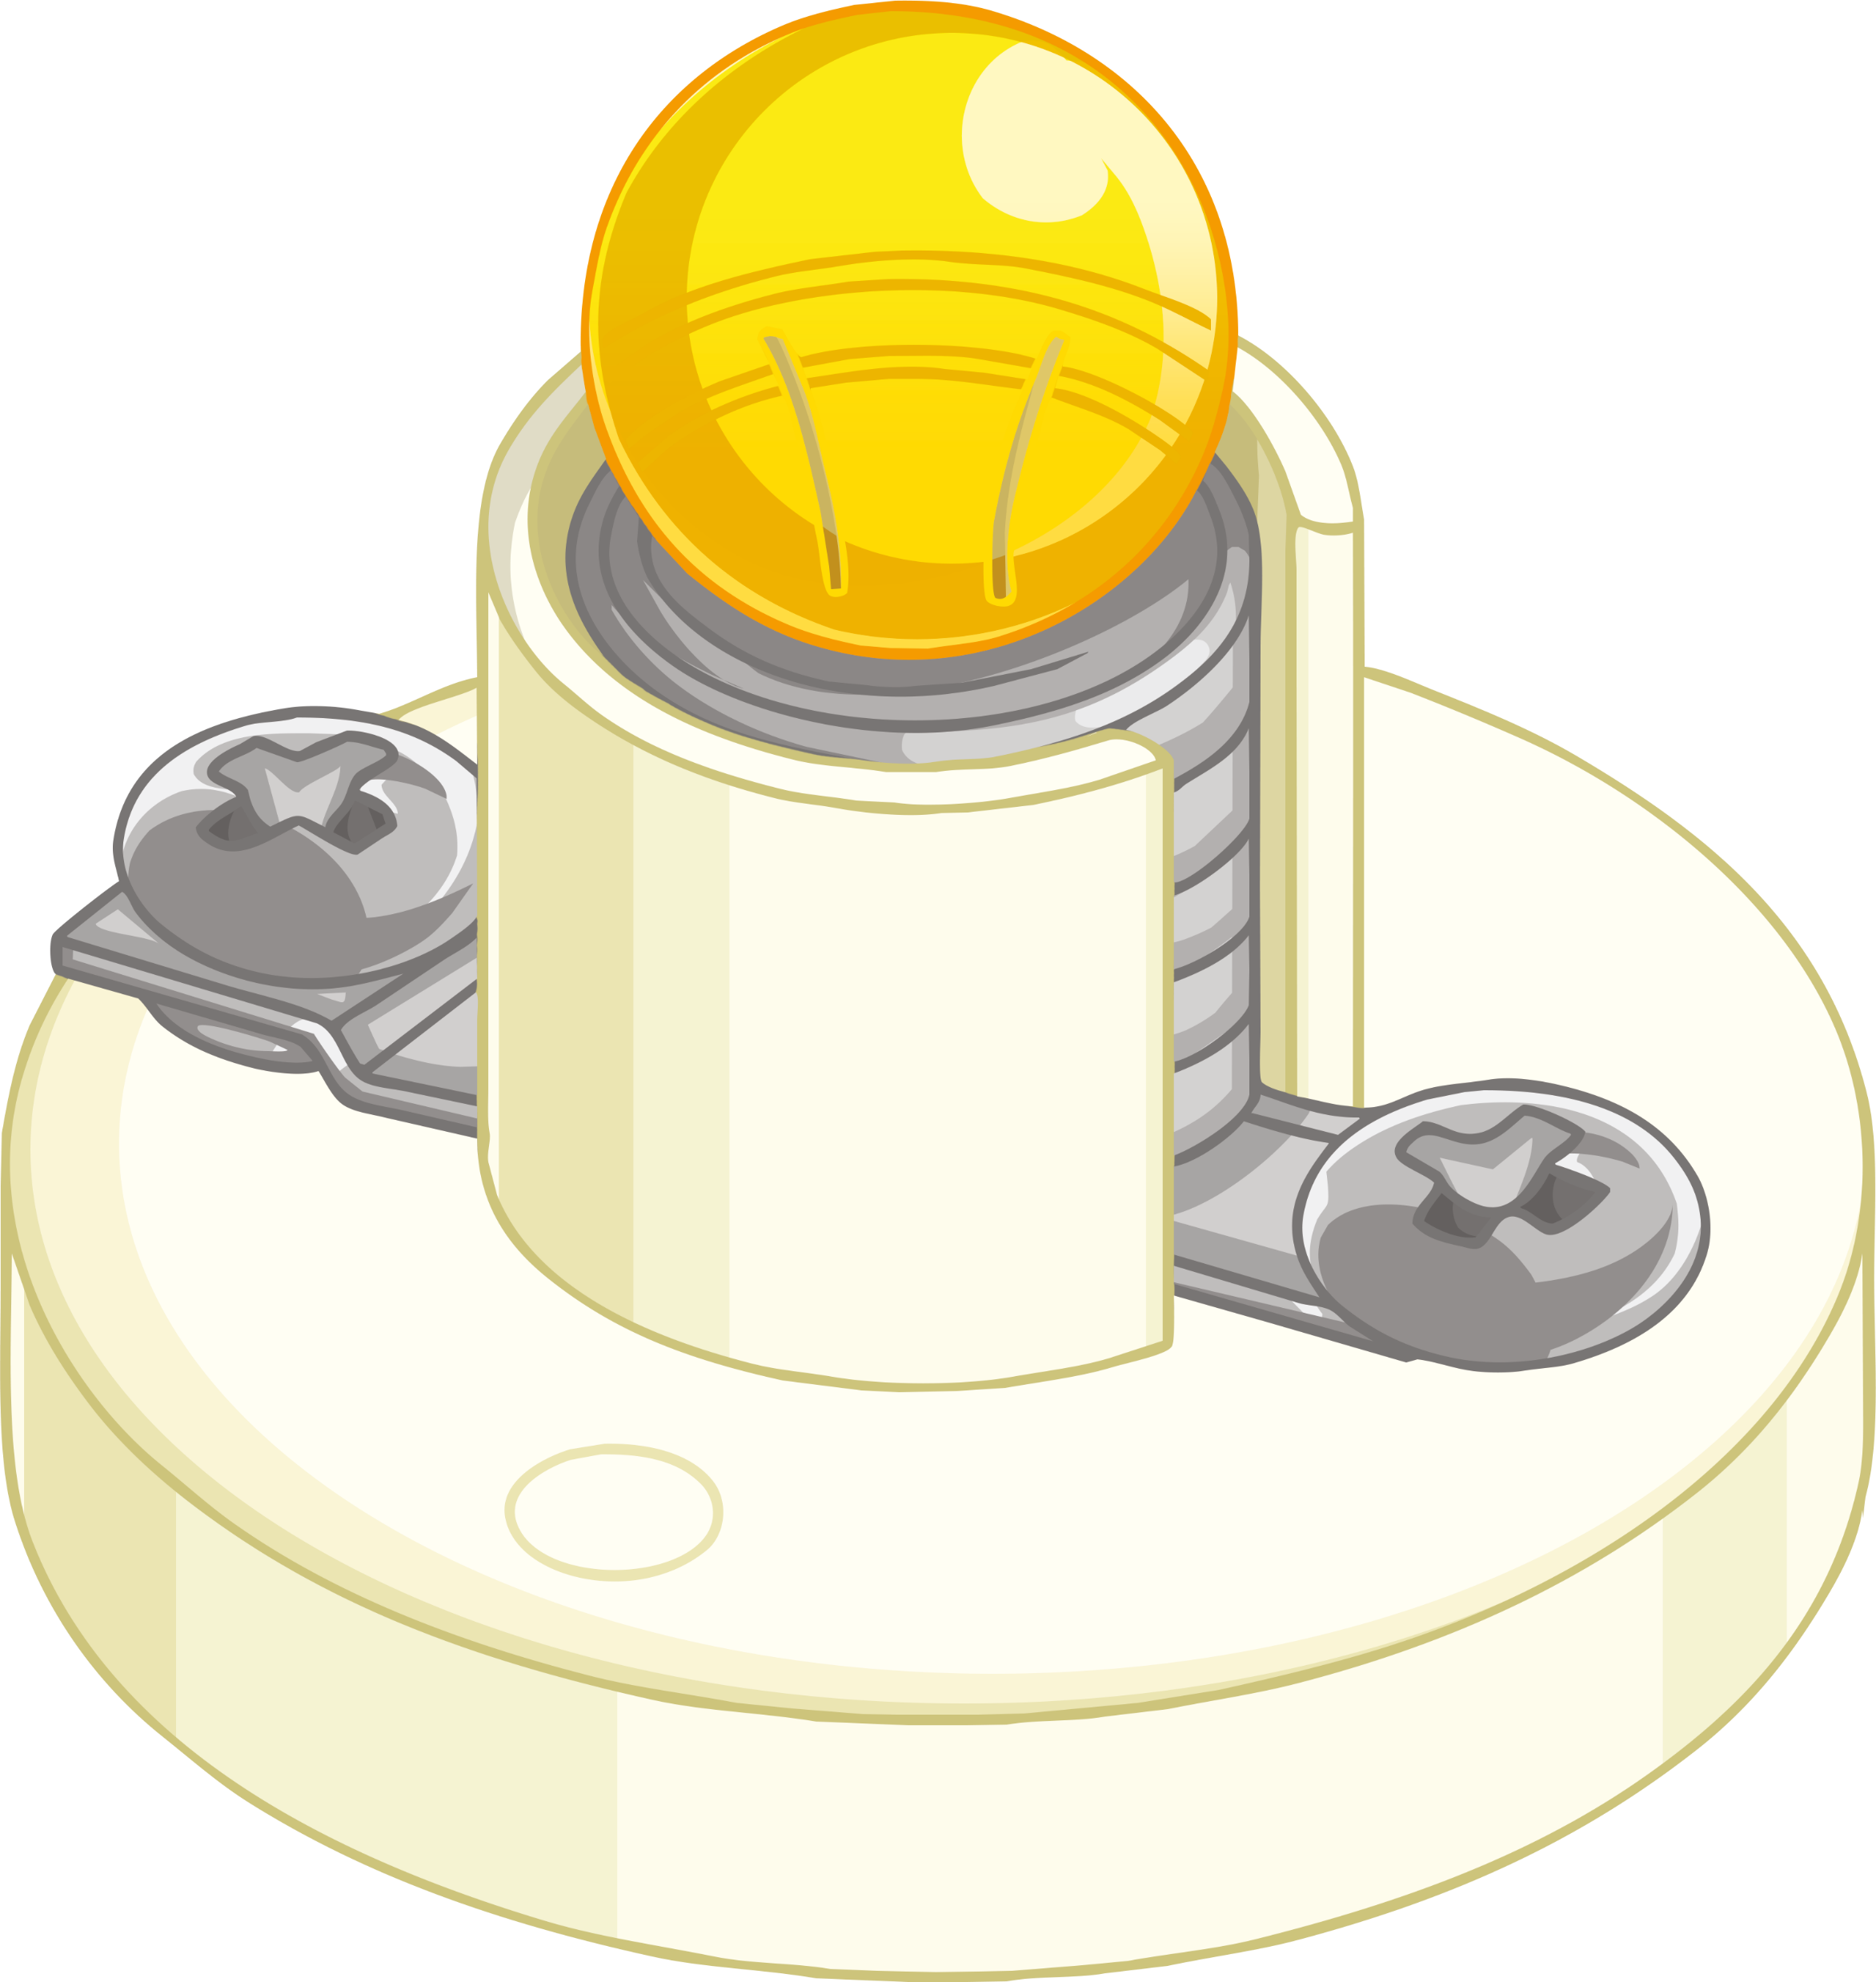
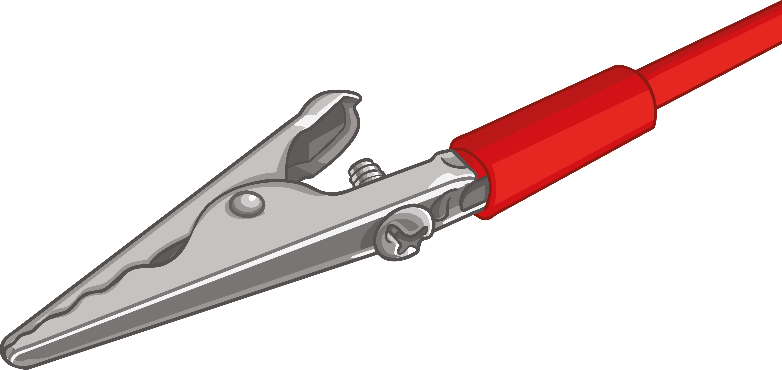
Scientific Circuit Symbols Quiz
Match the parts of a circuit with their scientific symbols.
(Sometimes there will be more than one symbol for a circuit part.)
Notes:
Buzzer (black circle)

Slide 7
Answers
Match the parts of a circuit with their scientific symbols.
(Sometimes there will be more than one symbol for a circuit part.)

Slide 8
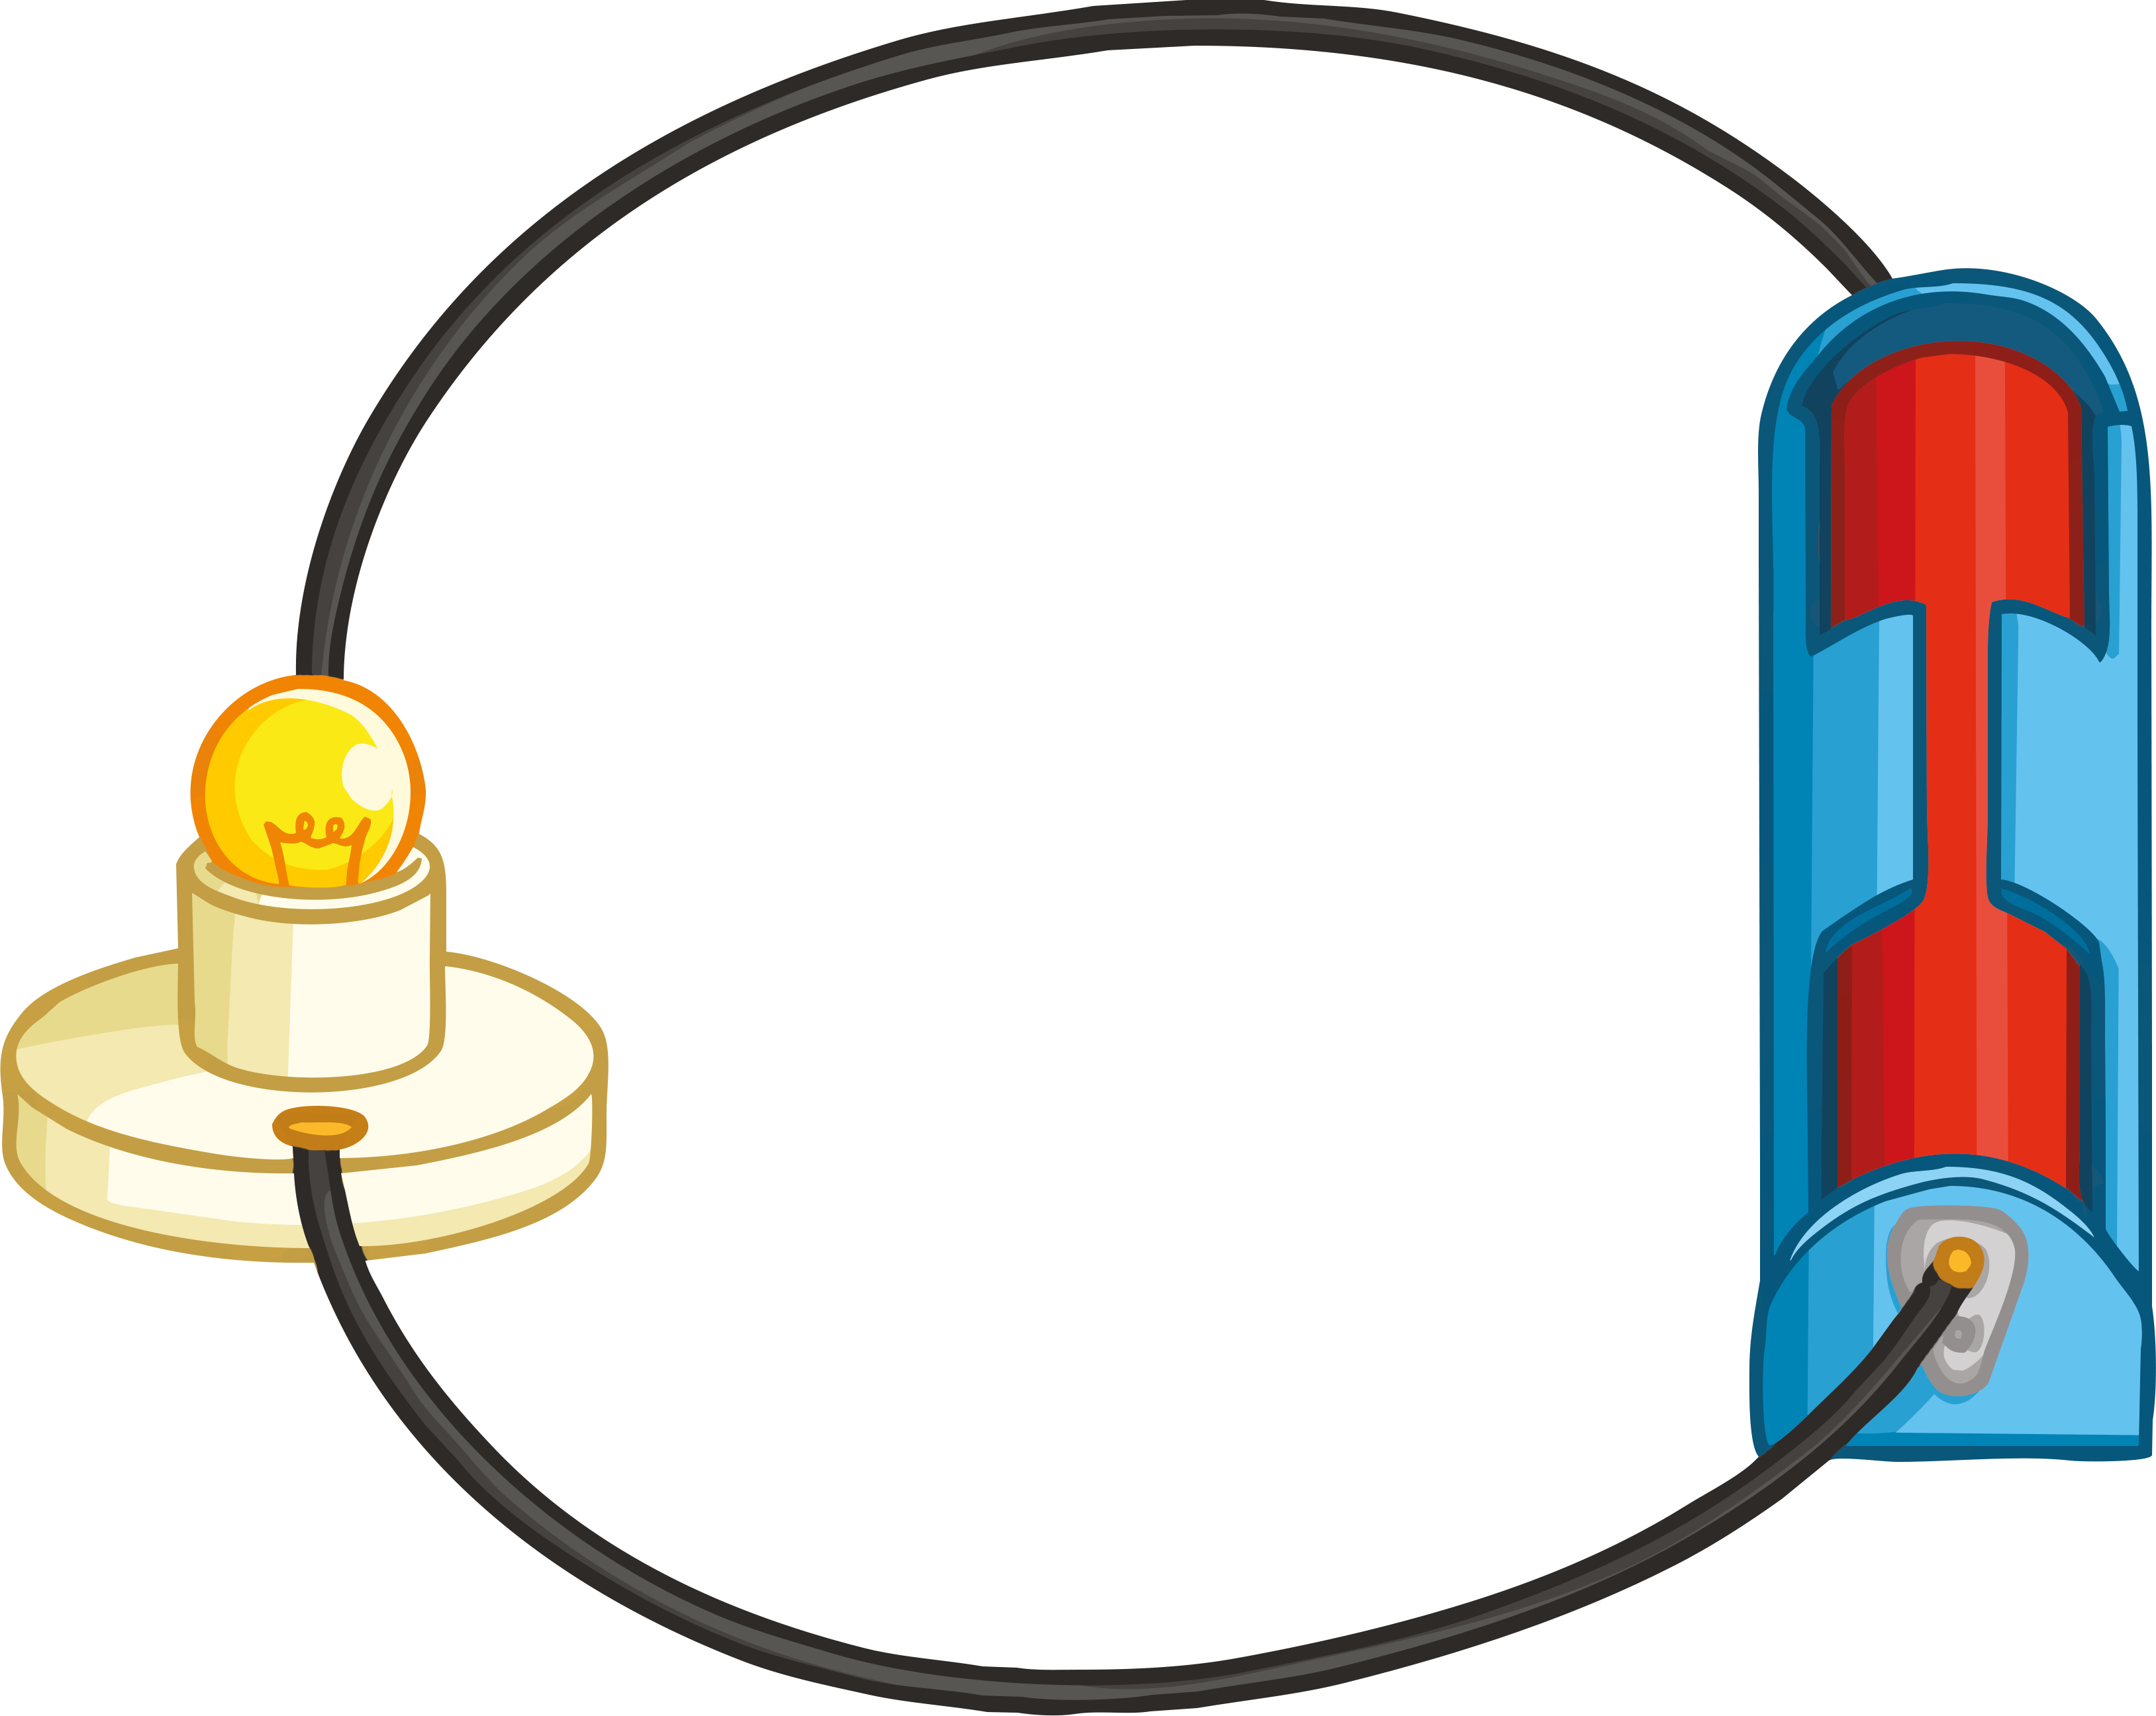
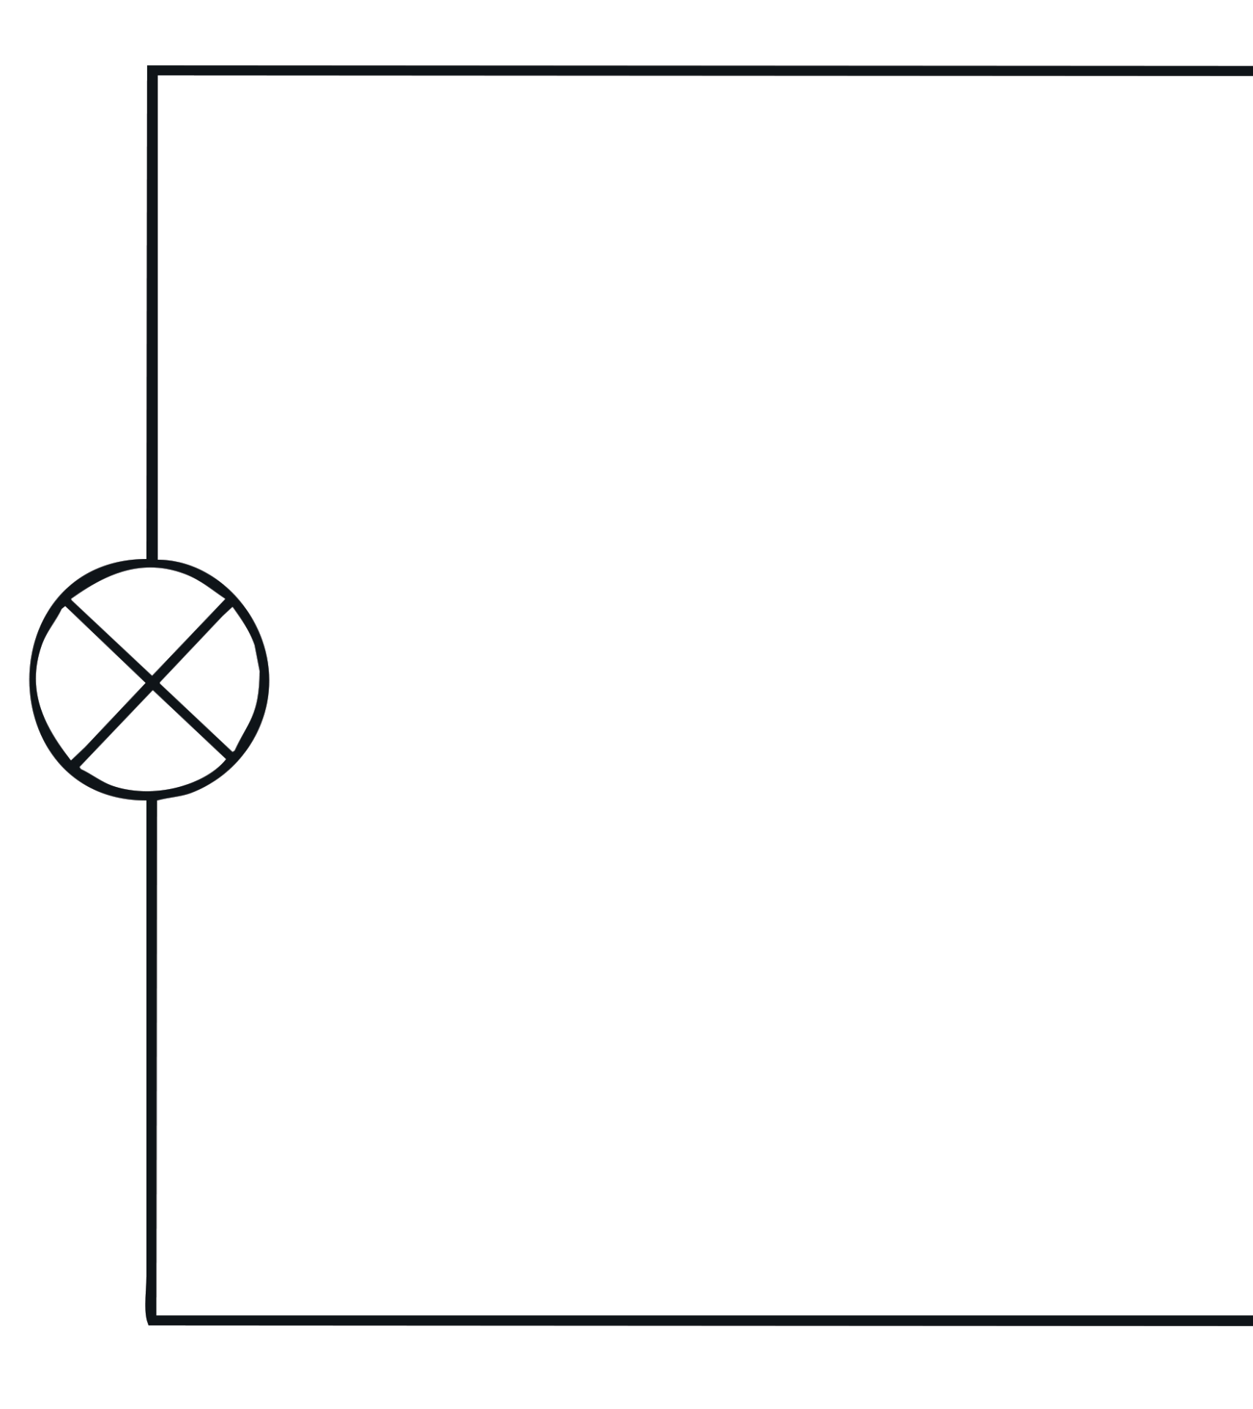
Circuit Symbol Diagrams
When it comes to drawing circuit diagrams, there are certain rules that we must follow every time.
1. Always draw circuits using straight lines.
2. Use a pencil and a ruler to draw these lines.
How would you begin to draw the circuit below?
Using the Drawing Circuits Activity Sheet, you will now have ten minutes to draw five series circuits using the rules above.

Slide 9
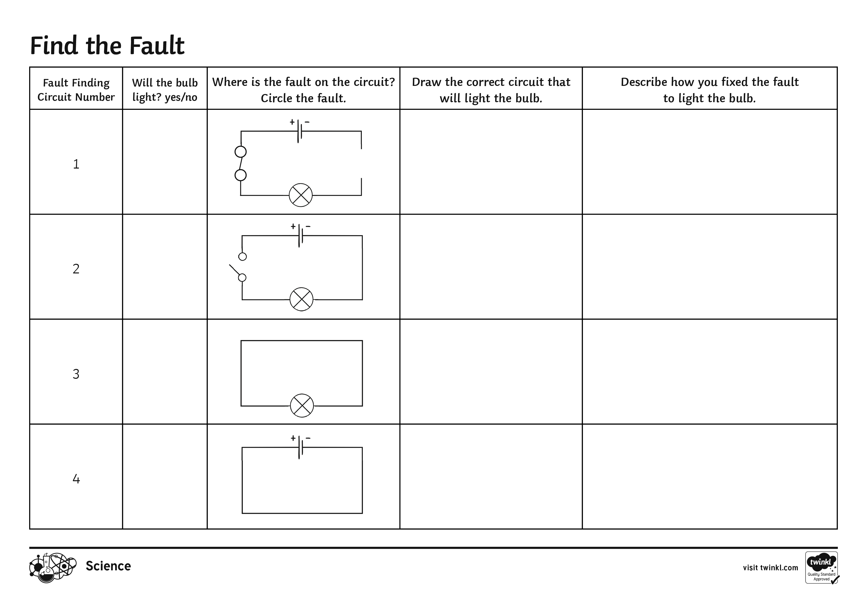
Fault-Finding
Now you know how to draw a circuit, can you find the fault?
There are six circuits that have been placed around the room. Each circuit has a fault in it.
Using the Fault-Finding Activity Sheet for each of the six circuits, you need to identify the fault and say whether you think the bulb will light or not.

Slide 10
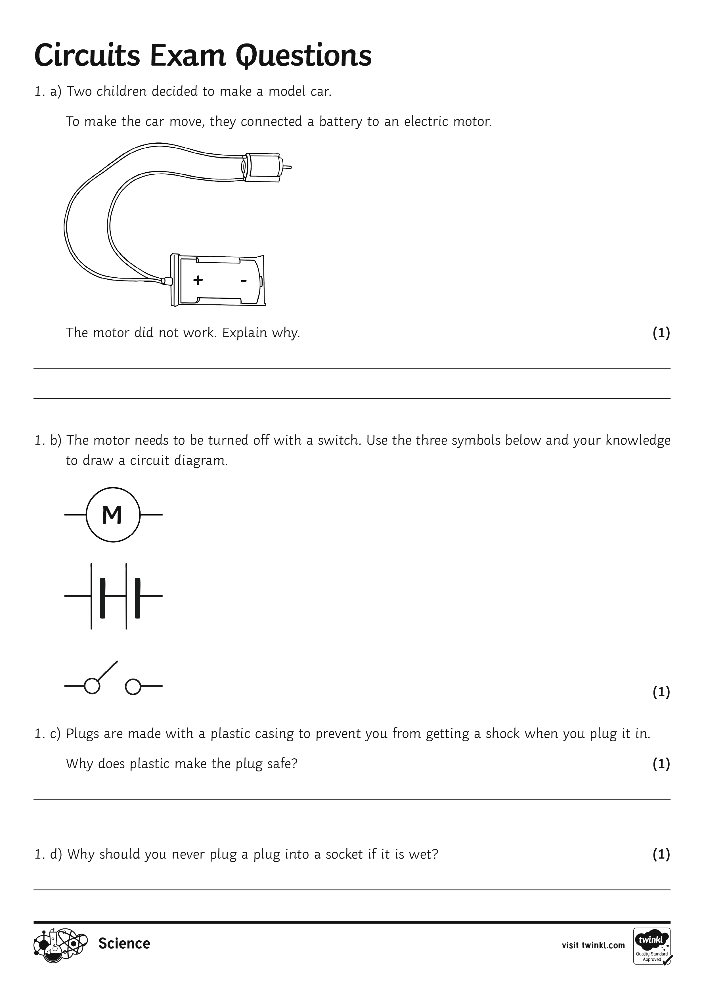
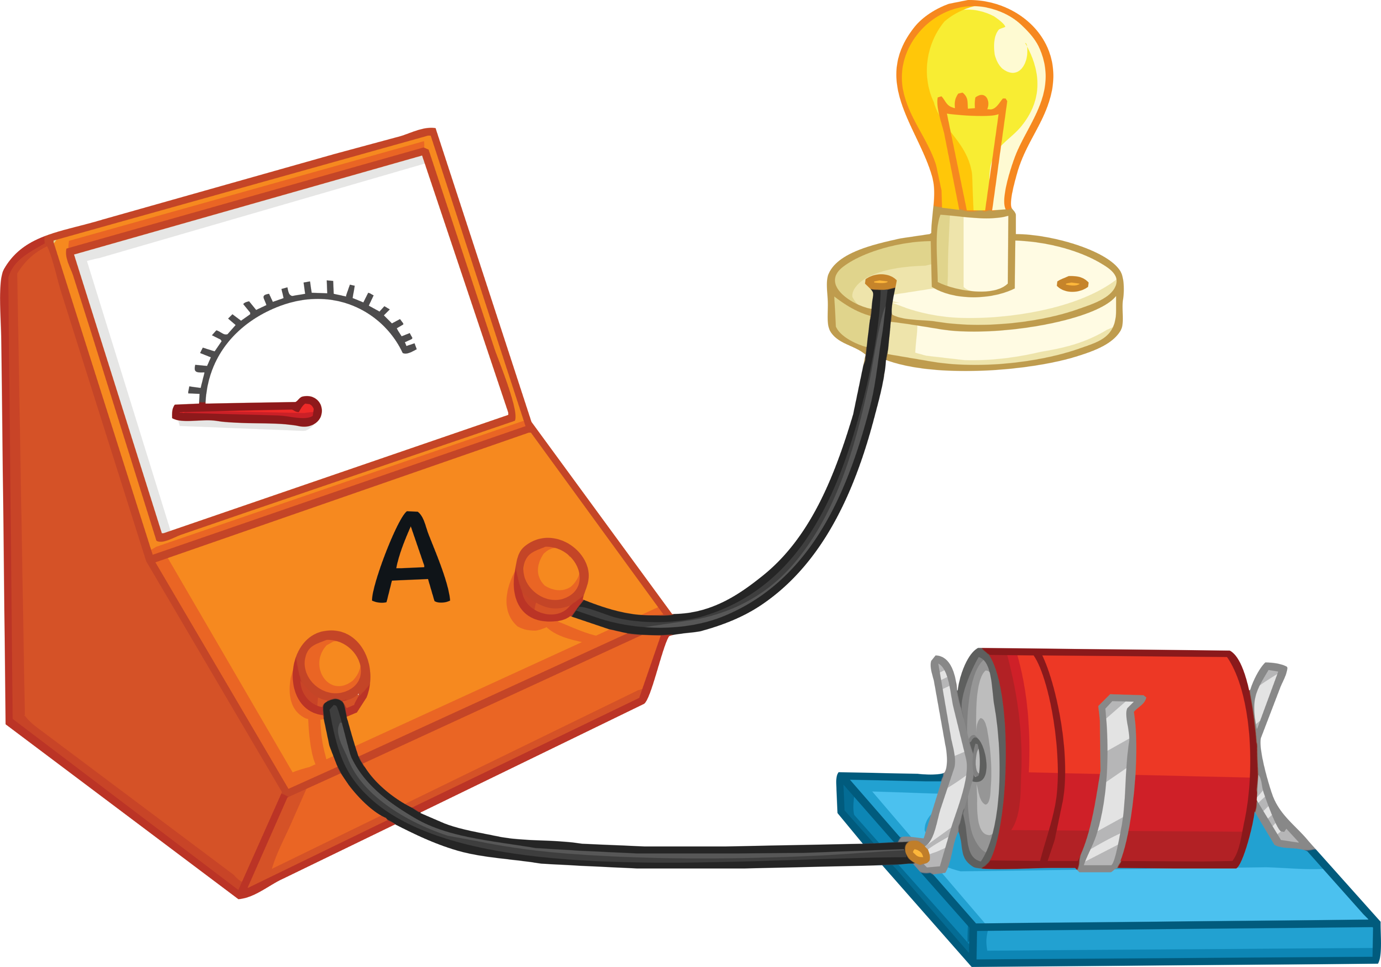
Exam Questions
Emily sets up an electric circuit.
In the diagram the ammeter reading is zero. What is wrong with this circuit?
Using the Circuit Exam Questions Activity Sheet, you will now have ten minutes to answer the exam questions.

Slide 11


Plenary
What three facts would you tell a friend about electrical circuits?
Try to use some of the keywords from today’s lesson in your answer.
Keywords
bulb circuit open switch closed switch faults

Slide 12
Learning Objective
To understand why some circuits fail to work.
Success Criteria
To identify the symbols used to represent components in a circuit.
To describe why some circuits do not work.
To apply our knowledge of circuits to an exam question.

